Slide 1
FOOD HUB
Presented By:Team Tissot
Names
D.L.Ganesh(241FA04A55)
P.Anand Babu(241FA04A60)
T.Kowsik(241FA04A65)
K.Subba Reddy(241FA04B47)
Sec-22
--FOOD ORDERING SYSTEM

Slide 2
About FoodHub
FoodHub is a modern web-based food ordering application designed to make online food ordering simple and convenient.
Allows customers to browse different food categories.
Provides food search and filtering options.
Enables customers to add food items to their shopping cart.
Supports online order placement through Cash on Delivery.
Provides an admin dashboard to manage food items and customer orders.
Main Goal: To provide a convenient platform for customers and an efficient management system for administrators.

Slide 3
Project Objectives
Develop a responsive and user-friendly food ordering website.
Provide food search, categories and filtering.
Implement secure customer and admin authentication.
Provide shopping cart and automatic price calculation.
Enable customers to place and track orders.
Develop an admin dashboard for food and order management.
Store application data using MongoDB Atlas.

Slide 4
TECHNOLOGIES USED
Technology | Purpose
React.js | Building interactive user interfaces
Vite | Frontend development and build tool
Tailwind CSS | Styling and responsive design
JavaScript | Application functionality
React Router DOM | Navigation between pages
MongoDB Atlas | Cloud database
Vercel Serverless Functions | Backend API operations
JWT | User authentication
Bcrypt | Password hashing
GitHub | Source code management

Slide 5
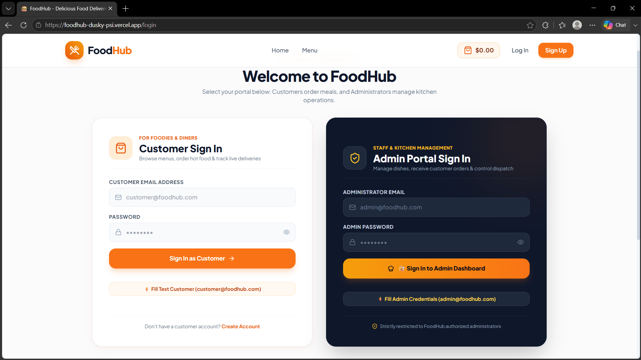
AUTHENTICATION MODULE
Customer registration and login.
Admin login.
JWT-based authentication.

Slide 6
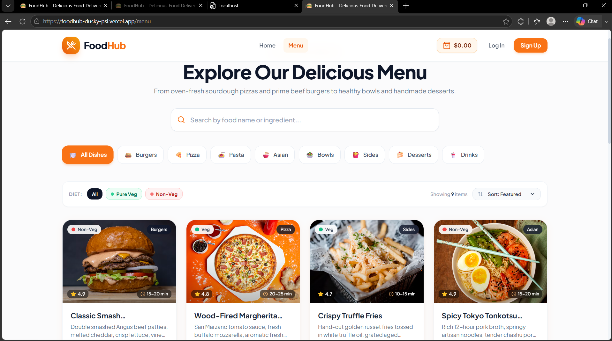
MENU MODULE
Display food items.
Search and category filtering.
Vegetarian and non-vegetarian filtering.
Sort by price and rating.

Slide 7
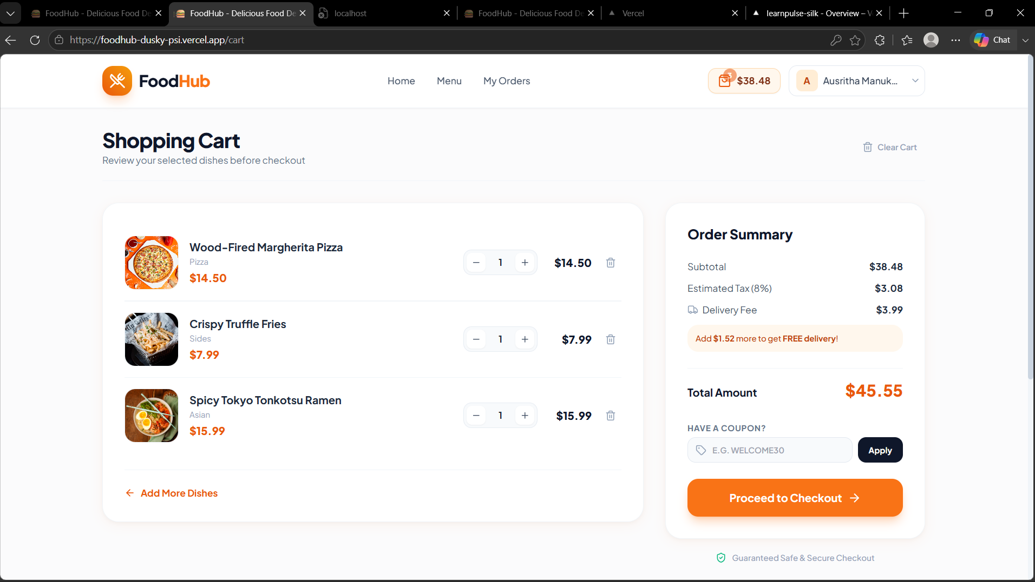
3. Shopping Cart Module
Add and remove food items.
Increase and decrease quantities.
Automatic subtotal and tax calculation.
Apply discount coupons.

Slide 8
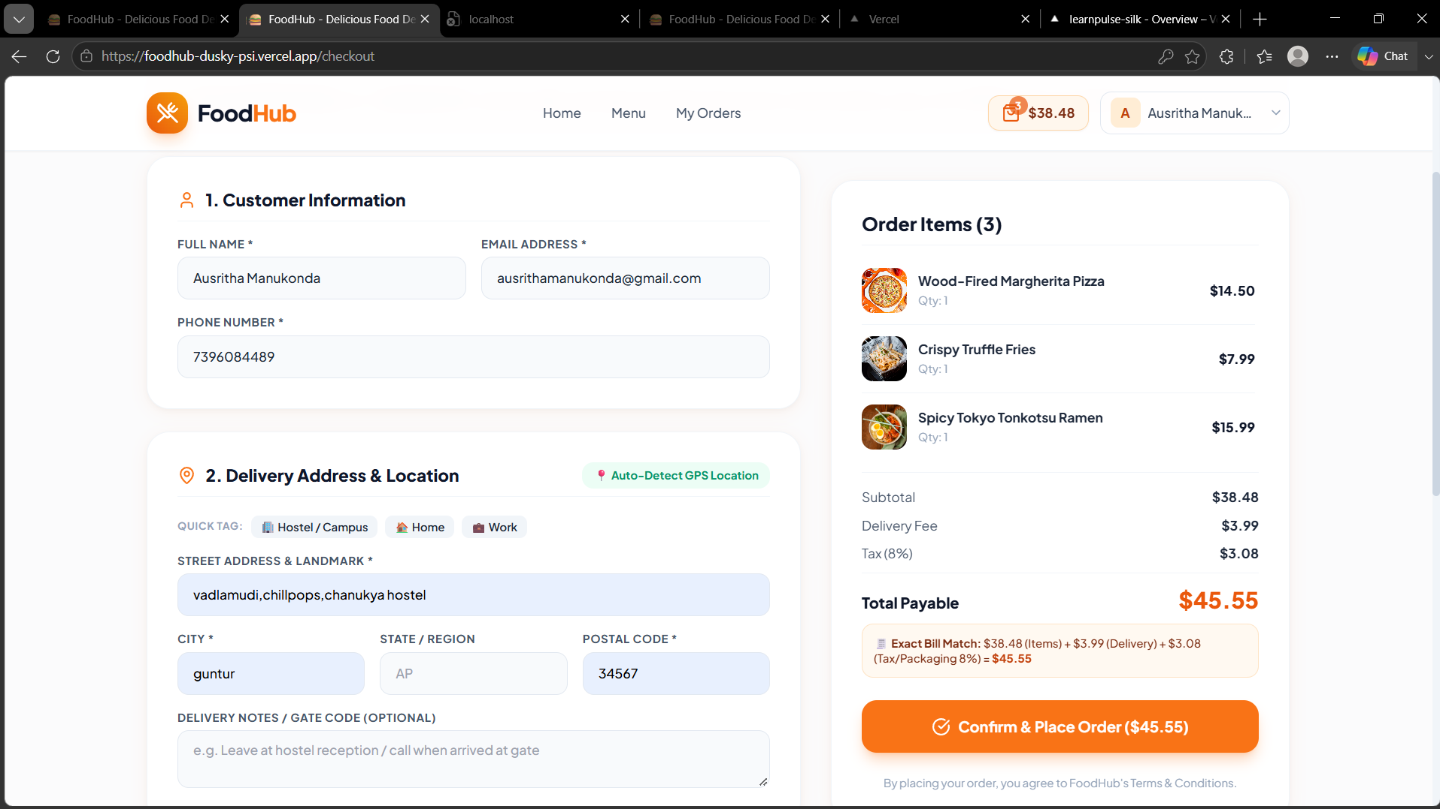
Order Management Module
Enter delivery details.
Place orders using Cash on Delivery.
View order history and order status.

Slide 9
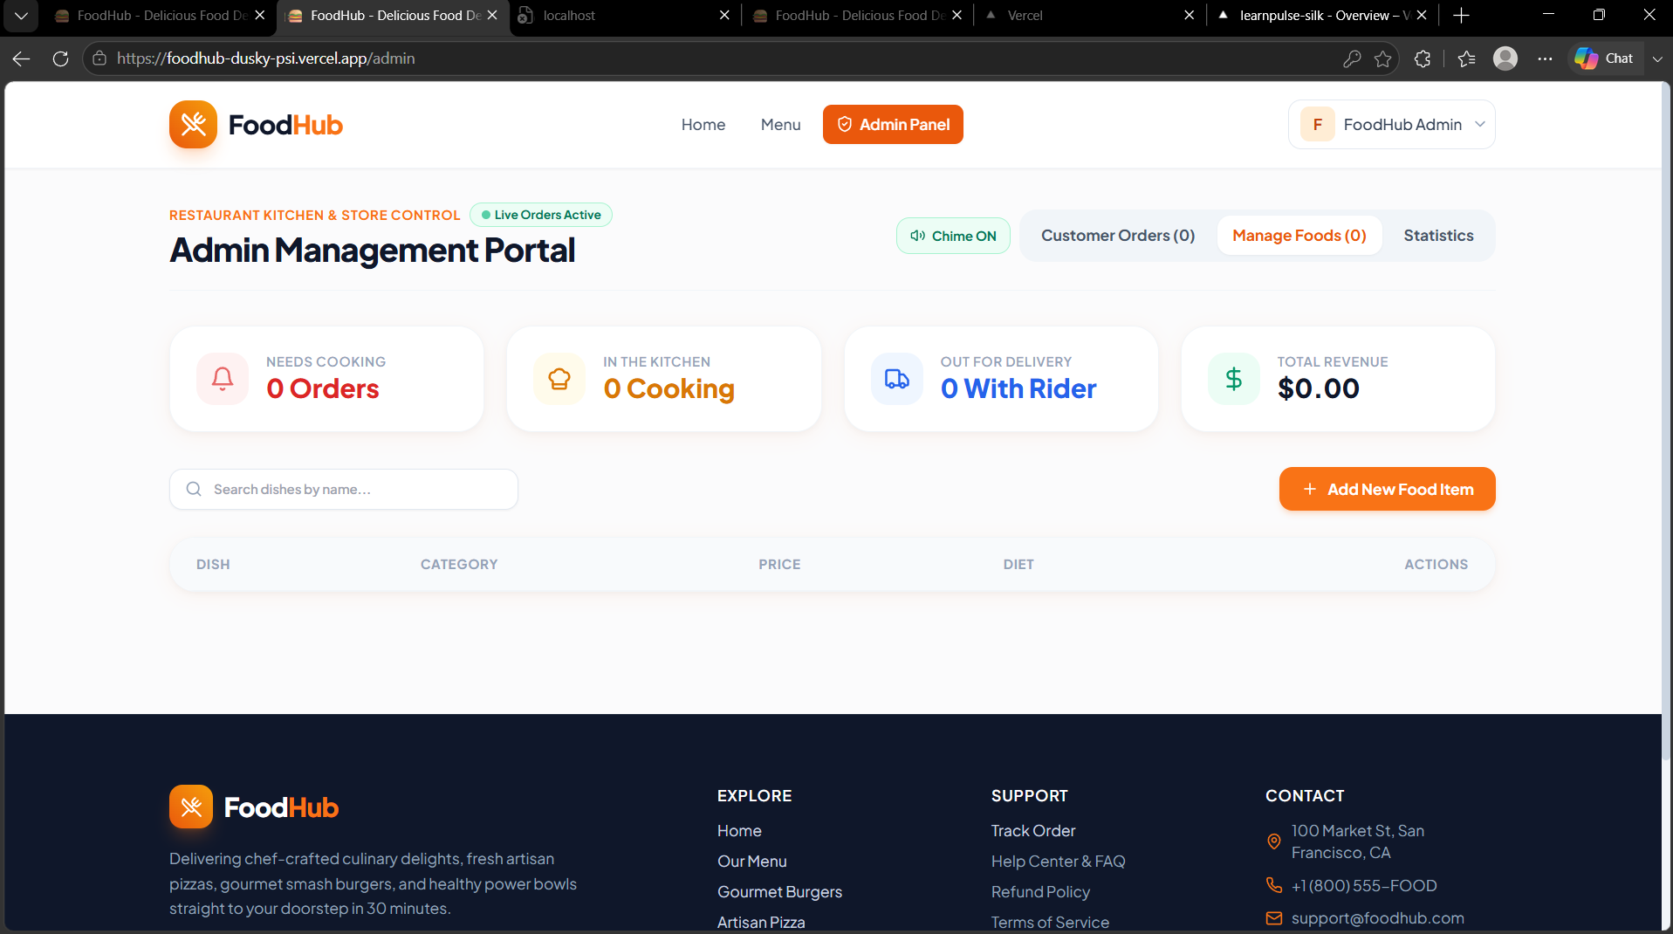
Admin Module
Add, update and delete food items.
View orders.
Update order status.
View dashboard analytics.

Slide 10


